Slide 1
MAC Spoofing and Counter measures

Slide 2
What is MAC address?
A MAC address is a series of characters that identifies a particular device on a network.
MAC stands for Media Access Control.
When a device is produced, the manufacturer assigns it a MAC address.
Unlike IP addresses, which can be dynamic, MAC addresses never change. It’s easier to identify a device on a network by looking at the MAC addresses.
The MAC address is hardcoded onto a device so it cannot be changed at the hardware level. It can be changed at the software level, though.

Slide 3
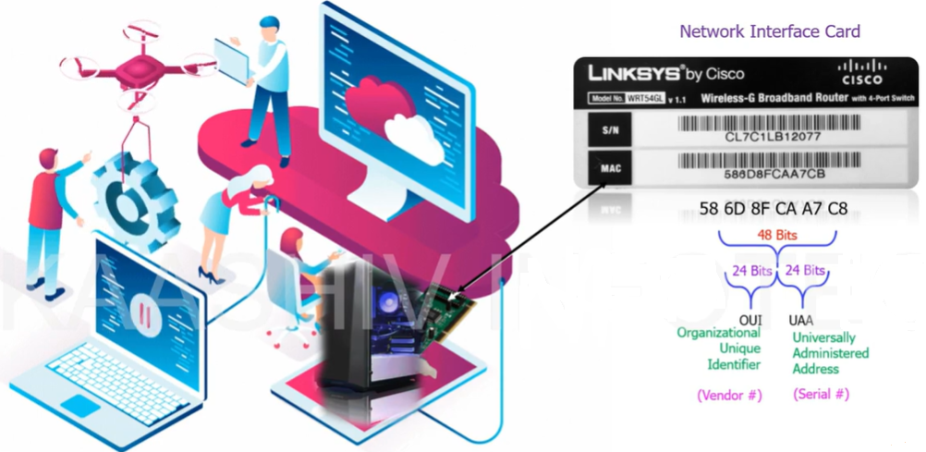

Slide 4
What is a MAC address (media access control address)?
A MAC address (media access control address) is a 12-digit hexadecimal number assigned to each device connected to the network.
Primarily specified as a unique identifier during device manufacturing, the MAC address is often found on a device's network interface card (NIC).
A MAC address is required when trying to locate a device or when performing diagnostics on a network device.
Each device on a network has a unique media access control (MAC) address, sometimes called a physical address.

Slide 5
Networking two devices requires an IP and MAC address. Every device’s NIC has a Media Access Control (MAC) address.
As a cybersecurity professional, you should know that no two devices may have the same MAC address since this identification is unique. The hexadecimal encoding 00:0a:95:9d:67:16 is present in every device.
The 12-digit alphanumeric identifier comprises 48 bits, with the initial 24 bits allocated for the OUI (Organization Unique Identifier), while the remaining 24 bits are designated for NIC/vendor-specific data.
It operates on the OSI model’s data link layer.
It is supplied by the device’s manufacturer and included in its NIC, which is ideally fixed and cannot be modified.
A logical address is connected to a physical or MAC address using the ARP protocol.
You can fake a device’s MAC address so it cannot be seen by public networks. This is known as MAC spoofing.

Slide 6
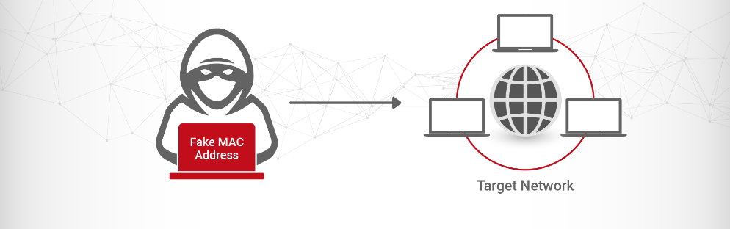
What is spoofing?
In the context of cybersecurity, spoofing is the act of impersonating another entity to earn our trust, obtain access to our systems, steal data, steal money, or transmit malware.

Slide 7
What is MAC Spoofing?
Each network-connected device possesses a distinct Media Access Control (MAC) address, which serves as an exclusive identifier assigned to its network interface card.
Malicious actors possess the ability to utilize the method commonly known as MAC spoofing to modify the MAC address of a device in order to imitate another device present on the network.
The vulnerability in question allows the attacker to bypass network security protocols that are dependent on MAC addresses, such as MAC filtering or access control based on MAC addresses.
Notes:
Draw analogy to the situation

Slide 8
Is spoofing a MAC address bad?
Spoofing a MAC address is legal and can be used for legitimate purposes, such as avoiding being tracked.
You can also do it safely without having to use any external software.
Often, however, MAC address spoofing is used for wicked purposes. It’s called a MAC spoofing attack

Slide 9
MAC Filtering
MAC filtering is a security method used in computer networks to restrict access to network resources based on the MAC address, a distinctive number that is provided to each network interface card (NIC)
Organizations can improve their network security by limiting unauthorized devices from connecting to the network and accessing critical data or resources by filtering network access at the MAC address level.

Slide 10
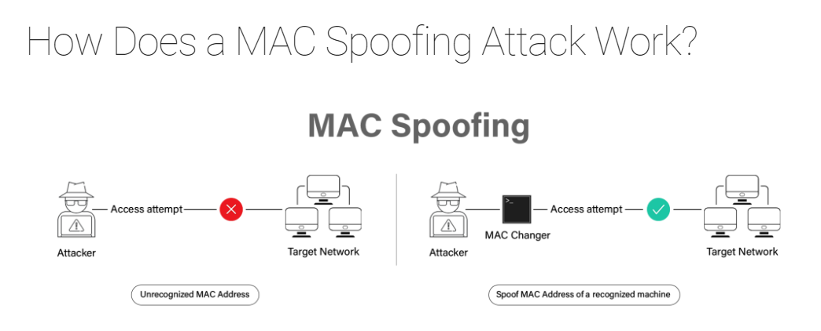
MAC spoofing is a commonly employed tactic by malicious actors to alter the Media Access Control (MAC) address of their device to mimic that of another device present on the network. The aforementioned vulnerability enables the assailant to surpass network security measures such as MAC filtering and MAC-based access controls.
Notes:
What is done after spoofing (active and passive)

Slide 11
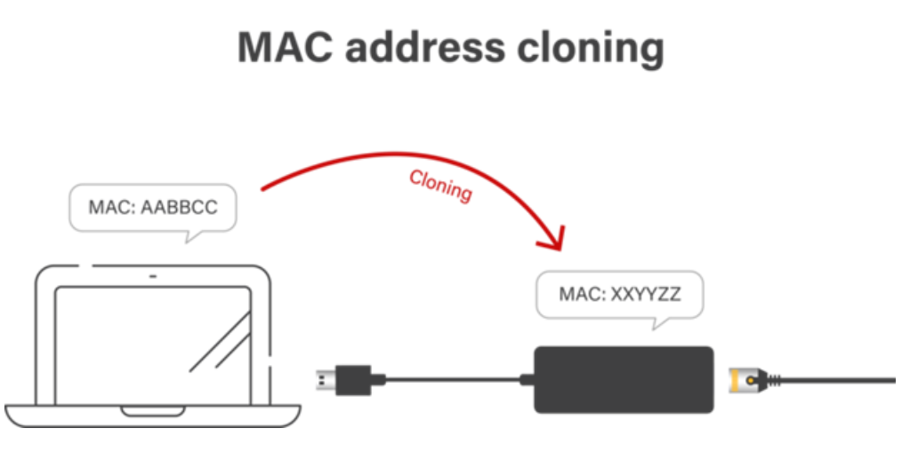
Techniques Used in MAC Spoofing Attacks
Cloning
The act of cloning involves the replication of a legitimate device’s MAC address for the purpose of masquerading as that device on the network. In instances where a perpetrator has unfettered physical access to a target device, such as a router or switch, this method is often employed.

Slide 12
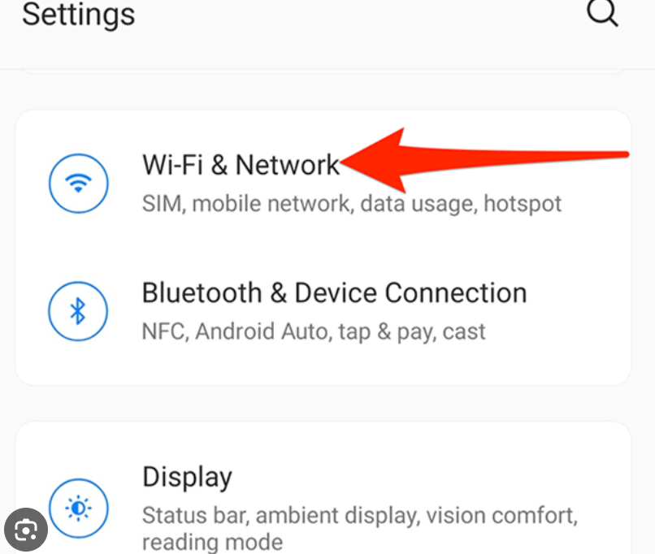
Techniques Used in MAC Spoofing Attacks
Randomizing a MAC address
Randomization involves generating a new MAC address and using it to impersonate a network device. When an attacker lacks access to a trusted device to copy its MAC address, they frequently apply this method.

Slide 13
Tools and Software Used for MAC Spoofing Attacks
MAC spoofing attacks are carried out by hackers using a range of tools and software, some of which are easily accessible online:
MAC address changer
The utilization of a freely available software, namely MAC Address Changer, empowers users to alter the MAC address of their network interface card (NIC). MAC address spoofing is a potential vulnerability that can be leveraged by threat actors to compromise the network and obtain unauthorized access.
Ettercap
Ettercap is a robust software application utilized for scrutinizing network traffic and conducting security assessments. Additionally, by manipulating MAC addresses and intercepting network traffic, cybercriminals can carry out MAC spoofing attacks.
Other tools: Cain and Abel, Netcut, and SMAC are additional popular tools for MAC spoofing attacks. MITM attacks can be conducted using these tools, which can also be used to clone or randomize MAC addresses.
Video Link: https://www.youtube.com/watch?v=ogtWS6MfiWM

Slide 14
Warning Signs of MAC Spoofing Attacks
Duplicate IP addresses: The presence of a common IP address among various network devices may suggest that a malevolent actor is leveraging MAC spoofing techniques to impersonate a legitimate device.
Unknown MAC addresses: It is imperative for network administrators to maintain a record of the MAC addresses of all connected devices. The presence of unfamiliar MAC addresses on the network may suggest the possibility of MAC spoofing.
Unusual network activity: MAC spoofing attacks frequently include intercepting and altering network traffic. Network activity that is irregular or unexpected could be a symptom of a MAC spoofing attack.
Inconsistent device behavior: Devices that are being spoofed could act strangely or react differently than planned. This might be because the attacker was manipulating and intercepting network traffic.
Unexpected network failures: MAC spoofing attacks can cause network failures or disturbances. Unexpected network disruptions might be an indication of a MAC spoofing attack.

Slide 15
How to prevent MAC Spoofing
Using encryption technologies to protect network data could make it much harder for an attacker to perform a MAC faking attack.
Access Control Lists (ACLs) let network managers limit access to only media access control (MAC) addresses that have been approved.
You must be mindful of port security as well.
Dynamic ARP Inspection (DAI) is a security mechanism that enables the validation of Address Resolution Protocol (ARP) requests and responses within a network.

Slide 16
Types of Spoofing
Email Spoofing
IP Spoofing
Website Spoofing
Phone Spoofing
Text Message Spoofing
ARP Spoofing
DNS Spoofing
GPS Spoofing
Facial Spoofing

Slide 17
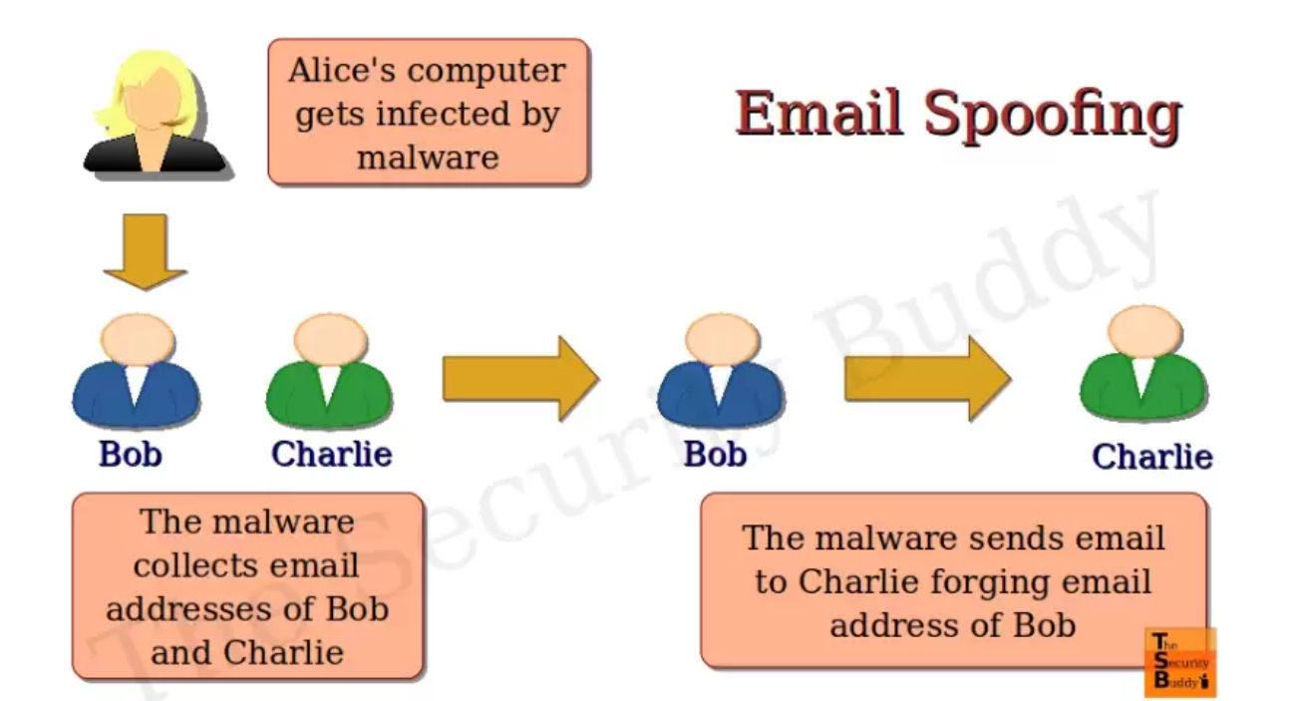
Email spoofing
Email spoofing is one of the most common types of cyberattacks. It happens when the sender forges email headers so that client software shows the false sender address, which most users accept at face value. Unless email receivers read the title thoroughly, they presume the bogus sender sent the message. If consumers recognize the brand, they are more inclined to trust it.
Fake emails often seek a money transfer or access to a system. In addition, they may include attachments that, when opened, install malware, such as Trojans or viruses. In many instances, malware is meant to infect the whole network in addition to your machine.
Email spoofing mainly depends on social engineering — the capacity to persuade human users that what they see is authentic, inciting them to take action by opening an attachment, transferring money, etc.

Slide 18
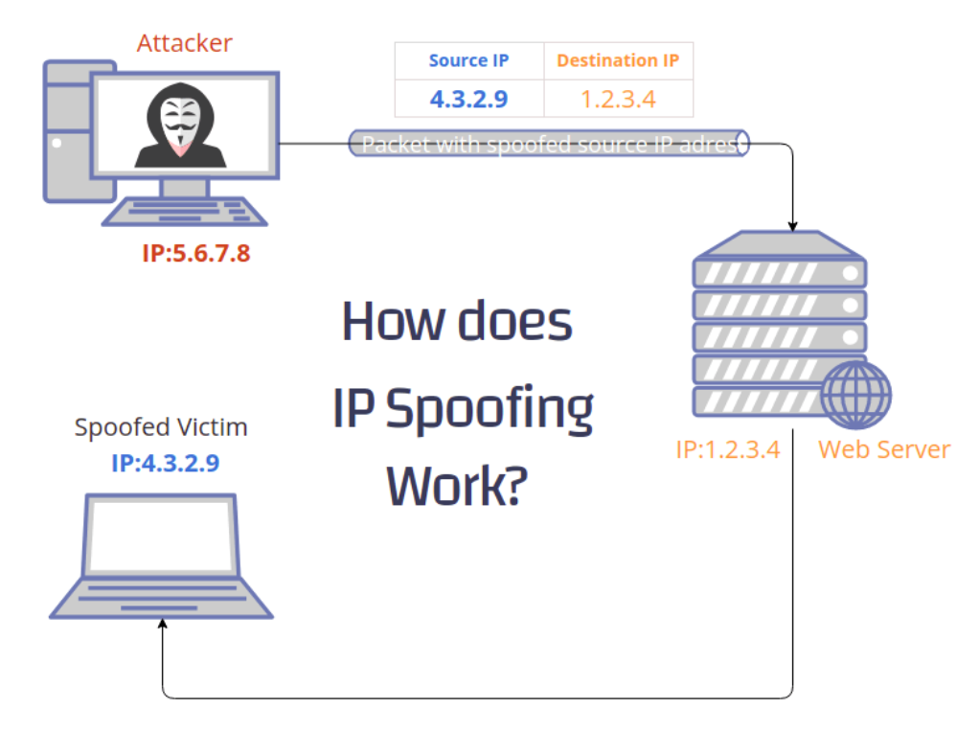
IP Spoofing
In contrast to email spoofing, IP spoofing is mainly directed toward a network.
IP spoofing includes an attacker attempting to obtain unauthorized access to a system by sending messages with a phony or spoofed IP address to make it seem as if the message originated from a trustworthy source, such as a computer on the same internal network.
Cybercriminals do this by stealing the IP address of a trustworthy host and modifying the packet headers transmitted from their system to make it look like they originated from the trusted machine. IP spoofing assaults are often part of DDoS (Distributed Denial of Service) attacks, which may take a whole network down. Therefore, it is crucial to detect them as soon as possible.

Slide 19
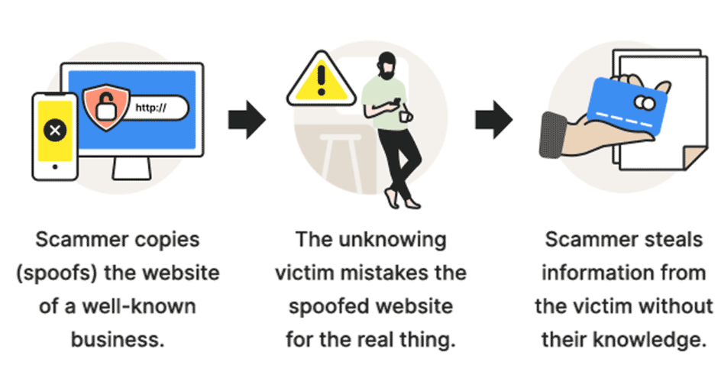
Website Spoofing
Website spoofing is impersonating a genuine website with a fraudulent one. The faked website will have a recognizable login page, stolen logos and comparable branding, and a URL that first looks to be correct.
Hackers create these websites to steal your login information and maybe infect your machine with malware. Frequently, website spoofing occurs in tandem with email spoofing; for instance, fraudsters may send you an email including a link to the bogus website.

Slide 20
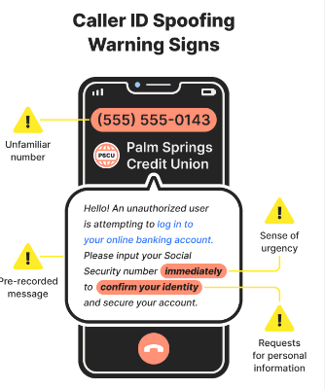
Caller ID or Phone Spoofing
Caller ID spoofing, also known as phone spoofing, occurs when con artists misrepresent the information supplied to your caller ID to conceal their identity. They do this because they are aware that you are more likely to answer your phone if it seems to be a local number rather than an unfamiliar one.

Slide 21
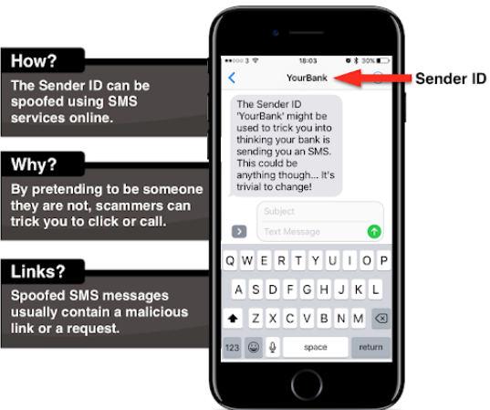
Text Message Spoofing
Text message spoofing, also known as SMS spoofing, occurs when the text message’s sender provides false information. Sometimes, legitimate firms replace a lengthy number with a short, easy-to-remember alphanumeric identifier to make it simpler for consumers. Scammers, on the other hand, conceal their true identity behind an alphanumeric sender ID, often posing as a reputable business or institution. These counterfeit messages often include links to SMS phishing (also known as “smishing“) websites or malware downloads.

Slide 22
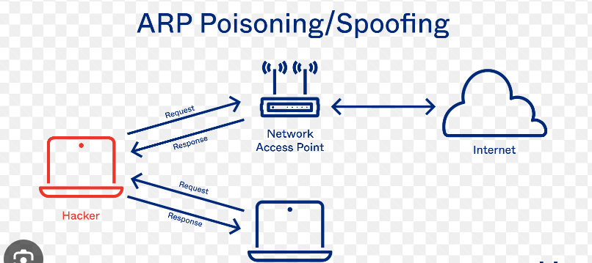
ARP Spoofing
ARP is a mechanism that allows network messages to reach a particular network device. ARP spoofing, also known as ARP poisoning, happens when an adversary transmits forged ARP packets over a local area network. This situation connects the MAC address of the attacker to the IP address of a genuine network device or service. This connection allows the attacker to intercept, alter, or even block any data destined for the IP address.

Slide 23
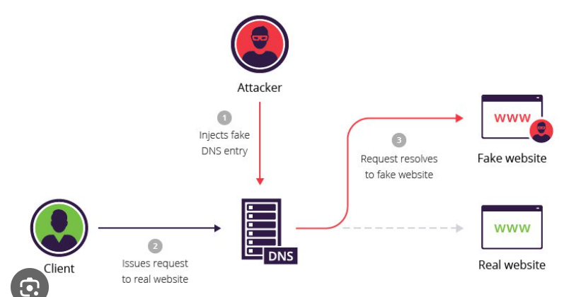
DNS Spoofing
DNS spoofing, also known as DNS cache poisoning, is an attack in which updated DNS records are used to redirect internet traffic to a sham website that closely mimics the actual destination. Spoofers do this by changing the IP addresses recorded on the DNS server with the IP addresses desired by the hackers.

Slide 24
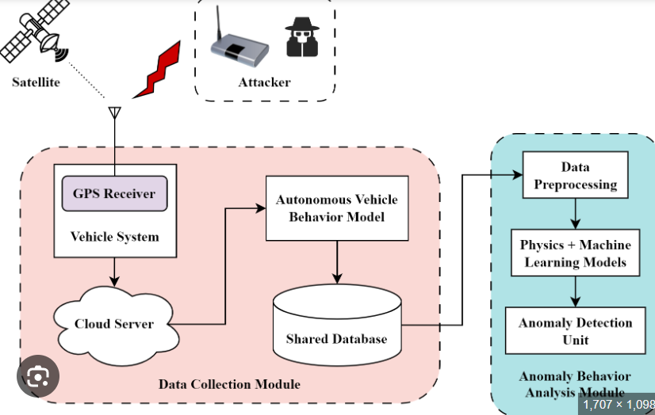
GPS Spoofing
GPS spoofing happens when a GPS receiver is misled into transmitting false signals that seem to be authentic. This indicates that the fraudsters are faking their location while being in another. This may be used to hack a car’s GPS and send you to the incorrect area or, on a much larger scale, to interfere with the GPS signals of ships or airplanes. Numerous mobile applications depend on location data from smartphones, making them susceptible to this kind of spoofing attack.

Slide 25
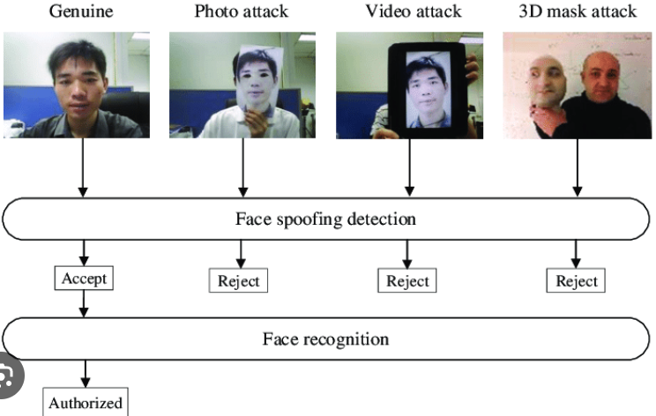
Facial Spoofing
Facial recognition technology is utilized in law enforcement, airport security, healthcare, education, marketing, and advertising, as well as to unlock mobile devices and computers. Facial recognition spoofing is possible using unlawfully acquired biometric data from an individual’s online profile or compromised system.

Slide 26
Counter measures
Activate your spam filter. This will prevent the vast majority of faked emails from reaching your inbox.
Do not click on links or download files in unsolicited emails from unknown senders. If there is a possibility that the email is accurate, contact the sender through an alternative route and validate the email’s contents.
Sign in from a different window or tab. Do not click the offered link if you get a suspicious email or text message demanding that you log in to your account and perform some action, such as verifying your details. Instead, create a new tab or window and browse the site. Alternatively, you may log in with the app on your smartphone or tablet.
Utilize the telephone. If you’ve received a strange email purportedly from a friend, don’t be hesitant to phone or text the sender to verify that they sent the email. This is particularly true if the sender makes an unusual request, such as, “Please purchase 100 iTunes gift cards and provide me the card numbers by email. Thanks, Your Employer.”
Windows displays file extension names. By default, Windows does not display file extensions, but you can alter this by choosing the “View” tab in File Explorer and selecting the checkbox to display file extensions. While this will not prevent fraudsters from spoofing file extensions, you will at least be able to identify faked extensions and avoid opening infected files.
Invest in reliable antivirus software. Don’t panic if you click on a malicious link or file; a competent antivirus application will warn you of the danger, block the download, and prevent malware from infiltrating your system or network. Malwarebytes, for instance, offers free trials of its antivirus/anti-malware software before subscription.
Notes:
What Is mac and ip -> Different parts of mac address

